Slide 1
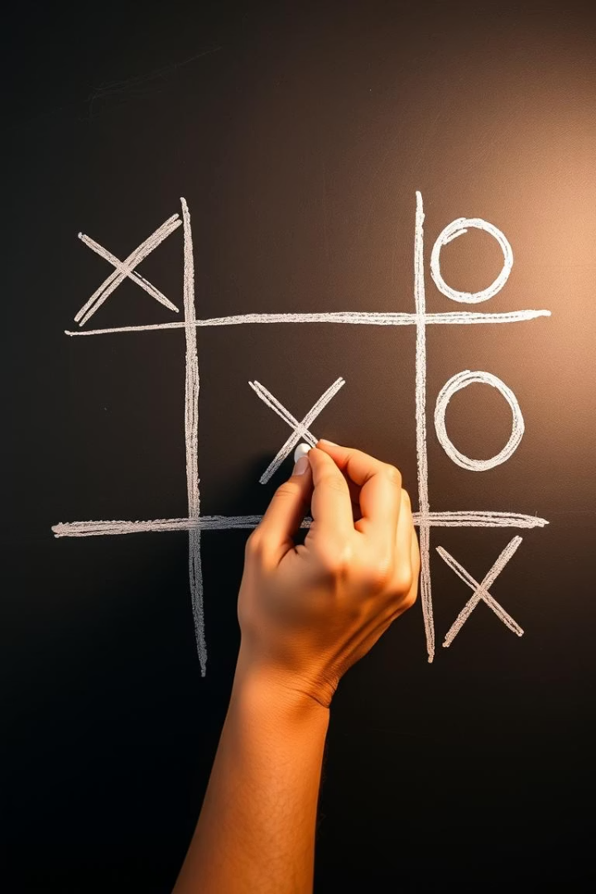
Tic-Tac-Toe: A Universal Game of Strategy
Tic-Tac-Toe is one of the world's oldest and most recognized games. It is often the first strategic game children learn. It emphasizes basic logic and pattern recognition.

Slide 2
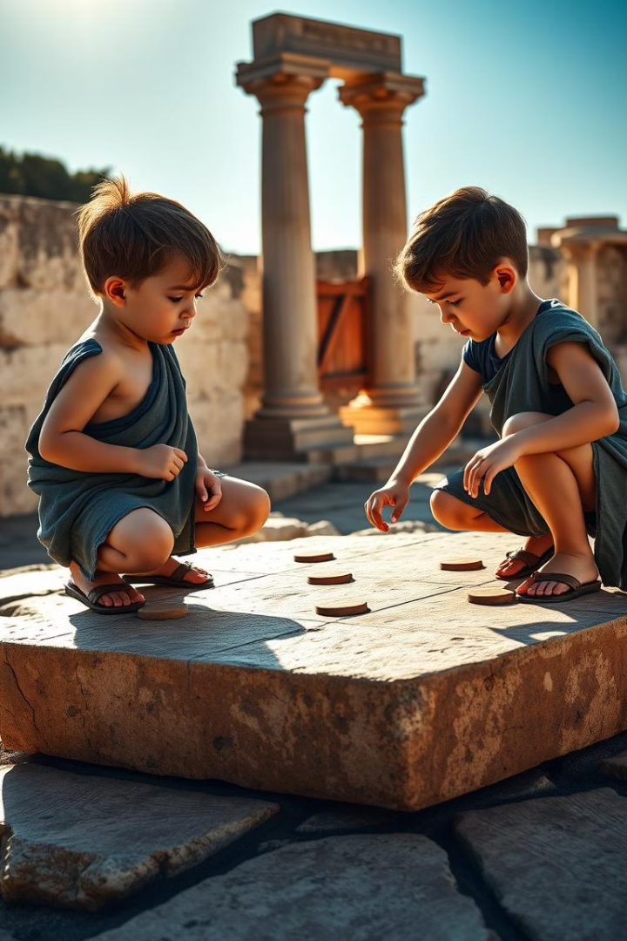
Ancient Origins & Evolution
1
Roman Empire (1st century BC)
"Terni Lapilli" was played on stone grids.
2
Ancient Egypt (1300 BC)
Similar games existed.
3
Medieval England (17th century)
"Noughts and Crosses" was popular.
4
First Computer Game (1952)
"OXO" by A.S. Douglas for EDSAC.

Slide 3
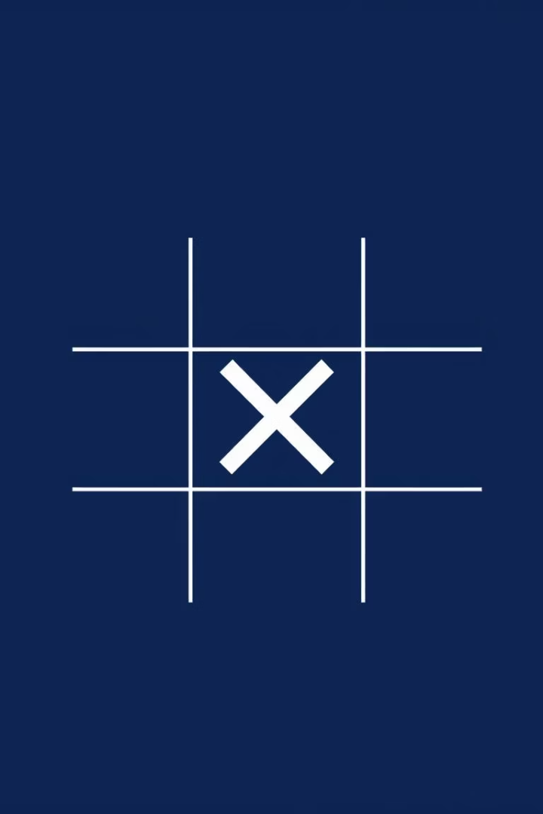
Simple Rules, Clear Objective
Two Players
X and O play on a 3x3 grid.
Objective
Be the first to get three marks in a row.
Winning Lines
Horizontal, vertical, or diagonal lines count.
Draw Game
Grid fills without a winner.

Slide 4
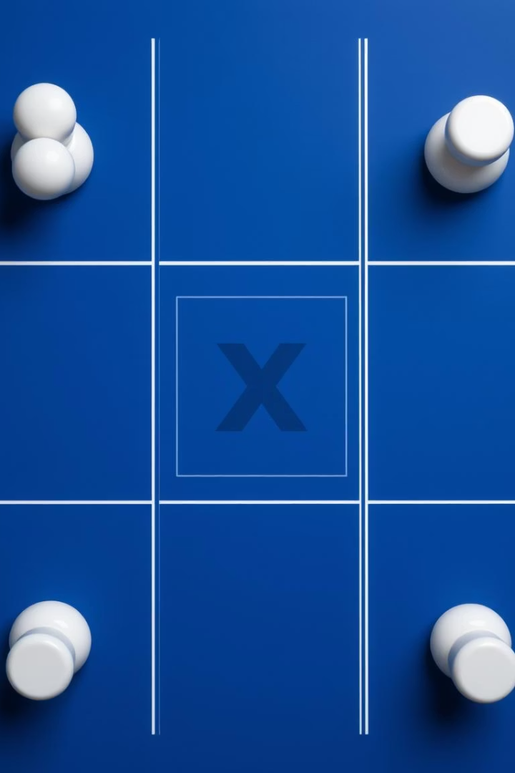




Core Game Mechanics
First Turn
Alternate Turns
Game Length
Player X typically starts the game.
Players place marks in empty squares.
Typically 5 to 9 moves.
Board Squares
There are 9 distinct squares.

Slide 5
Strategy & Optimal Play
The first player (X) can always force a draw or win. Optimal strategy involves controlling the center square, then corners. With optimal play, the game always results in a draw. There are only 8 unique opening moves due to board symmetry.
First player forces draw or win.
Control center, then corners.
Optimal play means a draw.
Only 8 unique opening moves.

Slide 6
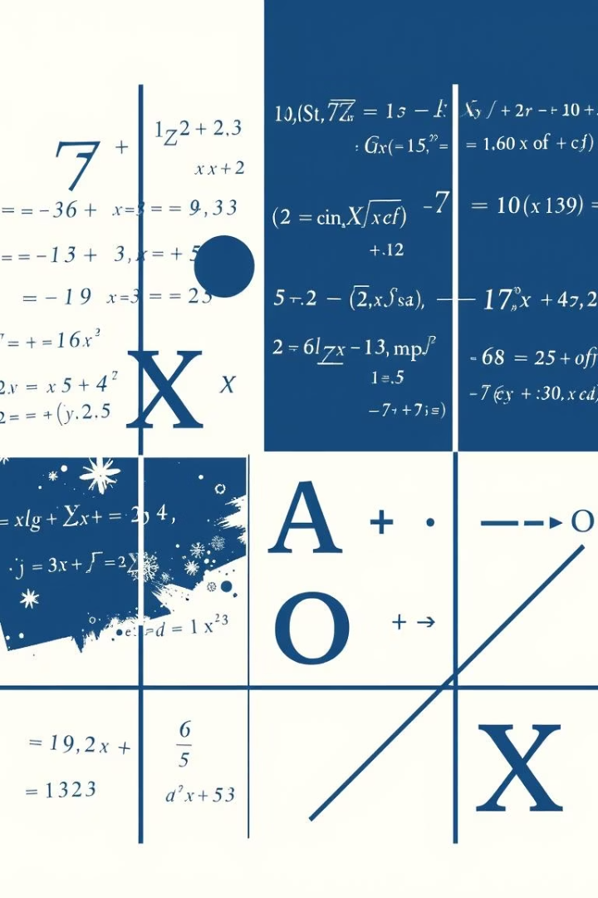
Mathematical Depth & Solved Game
255,168
765
5,478
Board Configurations
Unique Game States
Actual Game Sequences
Total possible including invalid states.
Excluding rotations and reflections.
Total number of game paths.
1
Solved Game
Due to its finite game tree.

Slide 7

Variations & Cultural Impact
Gomoku
A 5-in-a-row variant played on larger boards.
Teaching Tool
Introduces basic game theory and algorithms.
Pop Culture
Featured in "WarGames" and school notebooks.
Misere Play
Objective is to avoid getting three in a row.

Slide 8

Digital Evolution & AI Foundation
Early Digital Game
"OXO" (1952) was a pioneering digital game.
Programming Tutorials
Used for beginners to learn AI logic.
Mobile Apps
Millions of downloads for mobile versions.
AI Demonstration
Simple enough for early AI, demonstrates minimax.

Slide 9





Enduring Appeal
Simplicity
Accessible across all ages.
Strategic Depth
Engaging challenge for new players.
Game Theory
Foundation for complex understanding.
Timeless Classic
"Less is often more."

Slide 10
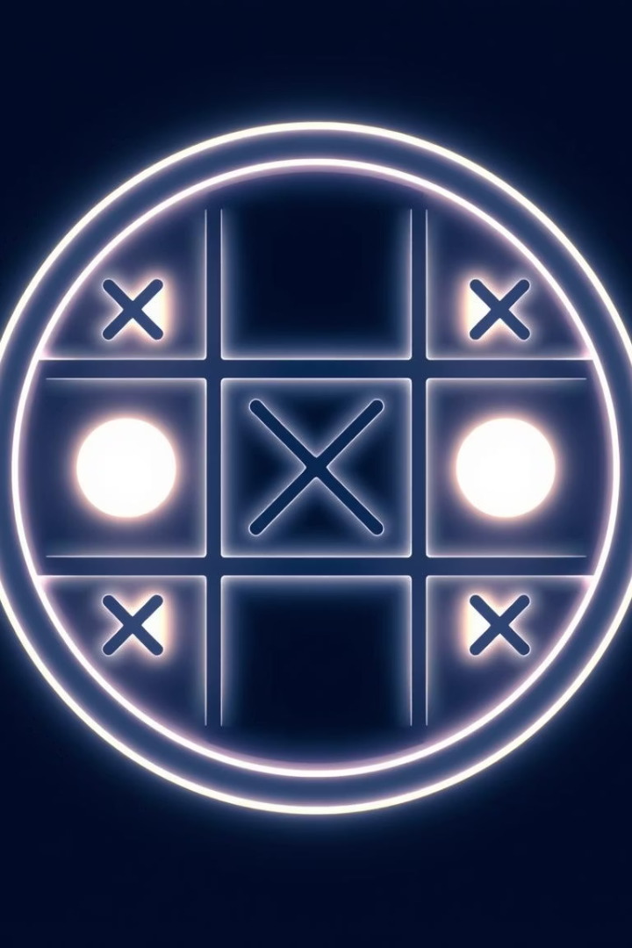
Conclusion: The Timeless Allure of Tic-Tac-Toe
Tic-Tac-Toe's enduring appeal lies in its elegant simplicity and surprising strategic depth. From ancient origins to its role in early AI, this humble grid game continues to captivate. It serves as a foundational learning tool. It proves that even the simplest concepts can offer profound engagement. Its legacy as a universal game of strategy remains firmly cemented.

